Slide 1
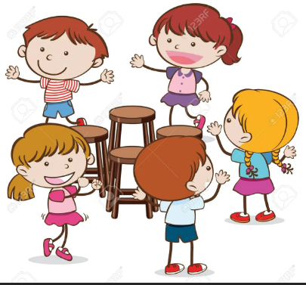
MUSICAL CHAIRS Playground game breakdown
By: David Antony Selvaraj A

Slide 2
Objective Of The Game
The objective of the game "Musical Chairs" is for players to be the last one to successfully find and sit in a chair when the music stops playing. The number of chairs is one less than the number of players.
So each time the music stops, one player is eliminated by not finding a chair to sit in. This continues until there is only one player left, who is declared the winner.
The game is typically played as a children's party game, but can be enjoyed by people of all ages

Slide 3
Game World
The rough estimate is:
For a min group of 6-8 players, you would need a circular area with a diameter of about 20-25 feet (6-7 meters).
For a larger group of 12 players, you would need a circular area with a diameter of about 30-35 feet (9-10 meters)

Slide 4
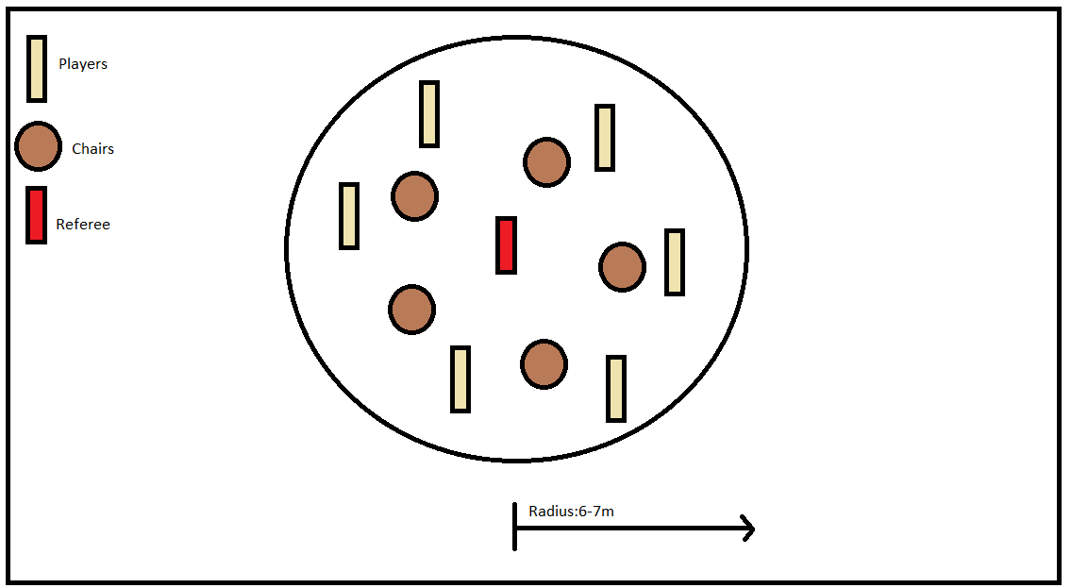
Game World Sketch

Slide 5
Ideal Number of Players
For a standard-sized adult chair, a group of 7 to 12 players would be a suitable number for a standard-sized room
larger group of 20 or more players if a larger space and more chairs are available.
1 referee who starts and stops music and also the one decides who wins and gets eliminated

Slide 6
Gameplay Sequence
Arrange chairs in a circle, facing inward, with one less chair than the number of players.
Players stand in a line, facing the chairs, and start walking around the circle in the same direction as the music.
When the music stops, players must race to sit in a chair.
The player who does not find a chair to sit in is eliminated.
The chairs are then removed and the process is repeated, with one fewer chair each time.
This continues until there is only one player left, who is declared the winner.
The game can be made more challenging by increasing the speed of the music or by incorporating additional rules or variations to the game.

Slide 7
Before Gameplay
Choose a suitable space: Ensure that you have enough room to play the game safely, taking into account the number of players and the size of the chairs.
Gather chairs: Obtain enough chairs for all but one player, with one less chair than the number of players.
Arrange chairs: Set up the chairs in a circle, facing inward, with enough space for players to walk around the circle.
Prepare music: Choose a suitable music source, such as a portable speaker or music player, and make sure that you have a way to start and stop the music.
Explain the rules: Make sure that all players understand the rules of the game, including how to play and what happens when the music stops.
Safety considerations: Ensure that the game is played in a safe manner, with players taking care to avoid collisions and to be considerate of others.
Start the game: Once all players are ready, start the music and begin playing the game.

Slide 8
Gameplay Phase
Start the music: Turn on the music and have players start walking in a circle around the chairs.
Keep walking: Players continue walking around the chairs as the music plays.
Stop the music: When the music stops, players must race to sit in a chair.
Eliminate a player: The player who does not find a chair to sit in is eliminated.
Remove a chair: Remove one chair from the circle.
Repeat: Repeat steps 1-5 until there is only one player left who has found a chair to sit in.
Declare the winner: The last player remaining is declared the winner.

Slide 9
Disqualification Rules
Not finding a chair: If a player does not find a chair to sit in when the music stops, they are disqualified.
Not following the rules: If a player does not follow the rules, such as pushing or tripping other players, they may be disqualified.
Using unfair advantage: If a player uses an unfair advantage, such as cutting in front of other players or taking more than one chair, they may be disqualified.
Leaving the playing area: If a player leaves the playing area during the game, they may be disqualified.

